Slide 1
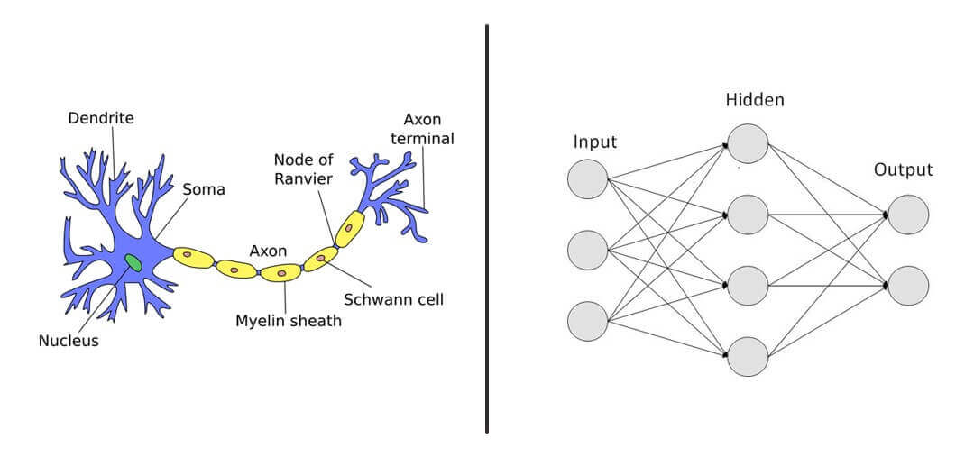

Slide 2
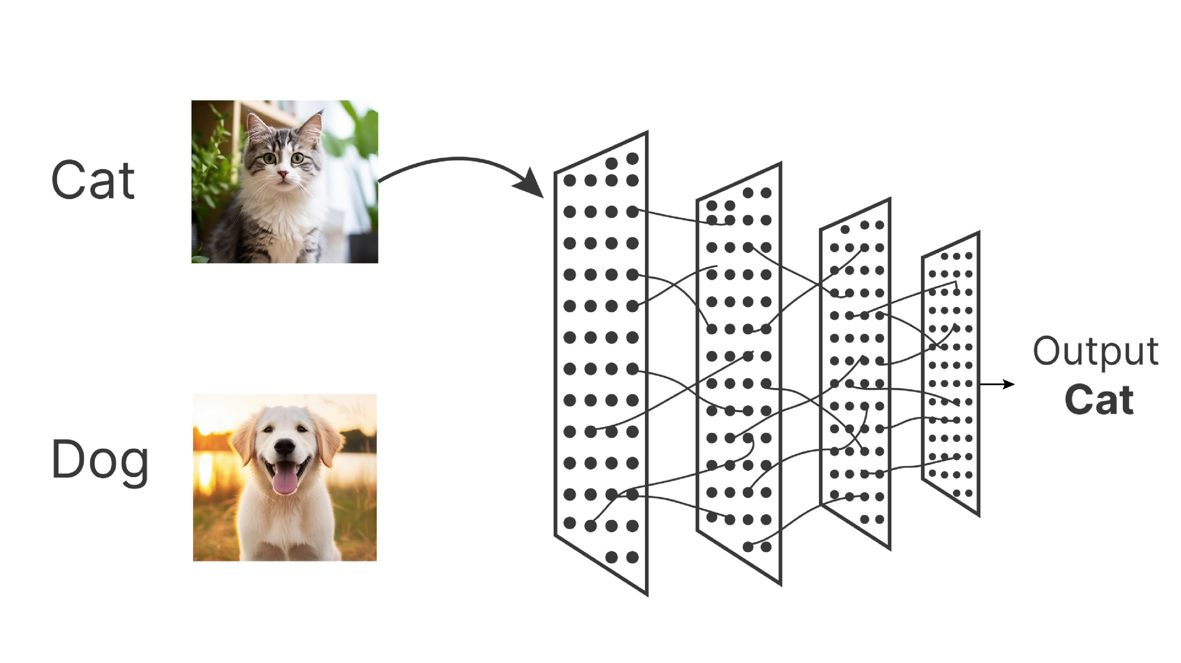

Slide 3
Perceptron model in Machine Learning
Perceptron is Machine Learning algorithm for supervised learning of various binary classification tasks.
Further, Perceptron is also understood as an Artificial Neuron or neural network unit that helps to detect certain input data computations in business intelligence.
Perceptron means single layer neural network

Slide 4
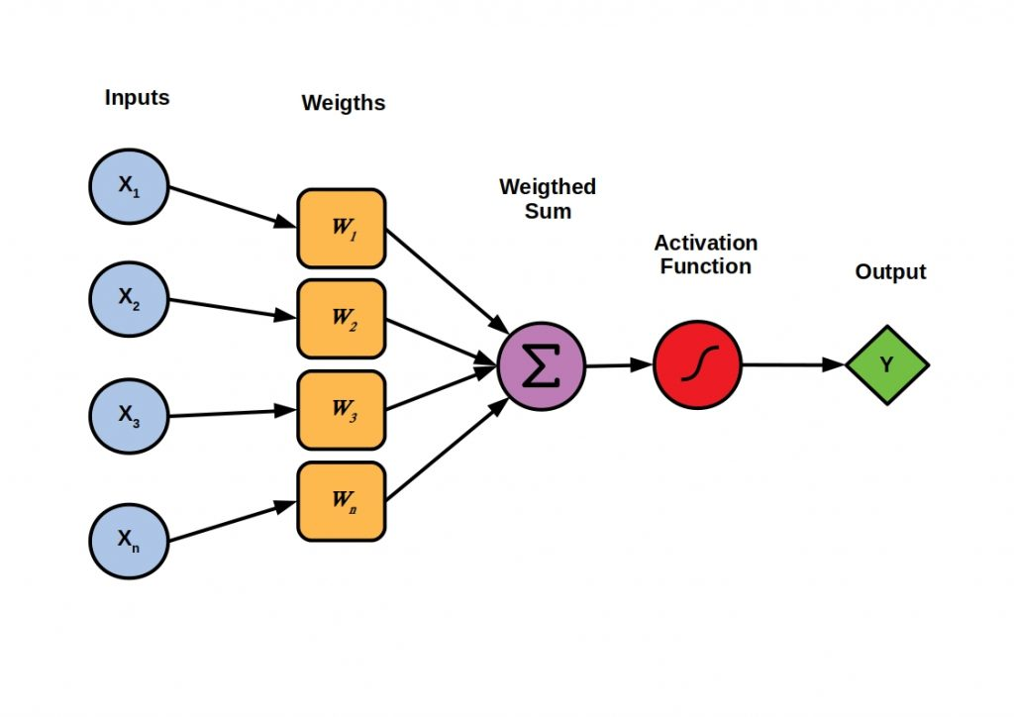

Slide 5
Input Nodes or Input Layer:
This is the primary component of Perceptron which accepts the initial data into the system for further processing. Each input node contains a real numerical value.
Wight and Bias:
Weight parameter represents the strength of the connection between units.
Bias can be considered as the line of intercept in a linear equation.

Slide 6
Activation Function:
These are the final and important components that help to determine whether the neuron will fire or not. Activation Function can be considered primarily as a step function.

Slide 7
Perceptron Example
Set a threshold value
Multiply all inputs with its weights
Sum all the results
Activate the output

Slide 8
Criteria | Input | Weight
Artists is Good | x1 = 0 or 1 | w1 = 0.7
Weather is Good | x2 = 0 or 1 | w2 = 0.6
Friend will Come | x3 = 0 or 1 | w3 = 0.5
Food is Served | x4 = 0 or 1 | w4 = 0.3
Alcohol is Served | x5 = 0 or 1 | w5 = 0.4

Slide 9
Set a threshold value:
Threshold = 1.5
2. Multiply all inputs with its weights:
x1 * w1 = 1 * 0.7 = 0.7
x2 * w2 = 0 * 0.6 = 0
x3 * w3 = 1 * 0.5 = 0.5
x4 * w4 = 0 * 0.3 = 0
x5 * w5 = 1 * 0.4 = 0.4
3. Sum all the results:
0.7 + 0 + 0.5 + 0 + 0.4 = 1.6 (The Weighted Sum)
4. Activate the Output:
Return true if the sum > 1.5 ("Yes I will go to the Concert")

Slide 10
Advantages of Multi-Layer Perceptron:
A multi-layered perceptron model can be used to solve complex non-linear problems.
It works well with both small and large input data.
It helps us to obtain quick predictions after the training.
It helps to obtain the same accuracy ratio with large as well as small data.

Slide 11
Disadvantages of Multi-Layer Perceptron:
In Multi-layer perceptron, computations are difficult and time-consuming.
In multi-layer Perceptron, it is difficult to predict how much the dependent variable affects each independent variable.
The model functioning depends on the quality of the training.

Slide 12


